Slide 1


Shi Chuanhua
17 Jun 2024

Slide 2

Outline
Executive Summary
Introduction
Methodology
Results
Conclusion
Appendix

Slide 3
Executive Summary
Summary of methodologies
Data Collection through API
Data Collection with Web Scraping
Data Wrangling
Exploratory Data Analysis with SQL
Exploratory Data Analysis with Data Visualization
Interactive Visual Analytics with Folium
Machine Learning Prediction
Summary of all results
Exploratory Data Analysis result
Interactive analytics in screenshots
Predictive Analytics result

Slide 4
Introduction
Project background and context
SpaceX advertises Falcon 9 rocket launches on its website at a cost of 62 million dollars; other providers cost upward of 165 million dollars each, and much of the savings is because SpaceX can reuse the first stage. Therefore if we can determine if the first stage will land, we can determine the cost of a launch. This information can be used if an alternate company wants to bid against SpaceX for a rocket launch.
Problems you want to find answers
How payload mass, launch site, number of flights, and orbits affect the first-stage landing success
Rate of successful landings in different circumstances.
Which is the best predictive model for successful landing

Slide 5

Section 1

Slide 6
Methodology
Executive Summary
Data collection methodology:
Data collected via Space X API as well as Wikipedia web scraping
Perform data wrangling
Data was transformed to the formats that allow data analytics, additional steps were taken to deal with missing values and create an outcome column for binary classification.
Perform exploratory data analysis (EDA) using visualization and SQL
Perform interactive visual analytics using Folium and Plotly Dash
Perform predictive analysis using classification models
Data collected were normalized, split into test and train data, evaluated using different techniques.

Slide 7
Data Collection
Describe how data sets were collected.
You need to present your data collection process use key phrases and flowcharts

Slide 8
Data Collection – SpaceX API
Call API to retrieve then parse the data
Filter the data to include only Falcon 9
Dealing with the missing values
Present your data collection with SpaceX REST calls using key phrases and flowcharts
https://github.com/Chuanhua512/IBMDataScience/blob/main/Module%201/jupyter-labs-spacex-data-collection-api.ipynb

Slide 9
Data Collection - Scraping
Retrieve the wiki page content using beautifulsoup
Extract the relevant header & values using the respective HTML tags
Joined the extracted data into a Dataframe
Present your web scraping process using key phrases and flowcharts
https://github.com/Chuanhua512/IBMDataScience/blob/main/Module%201/jupyter-labs-webscraping.ipynb

Slide 10
Data Wrangling
Data wrangling was done using Pandas
https://github.com/Chuanhua512/IBMDataScience/blob/main/Module%201/labs-jupyter-spacex-Data%20wrangling.ipynb
Load the csv file into Pandas DataFrame
Verify if there is null or missing values.
Identify which columns are numerical and categorical
Calculate the key figures for each category
Create new column that use numeric to represent the success or fail of an launch

Slide 11
EDA with Data Visualization
Summarize what charts were plotted and why you used those charts
I made use of scatter charts to observe if the following pairs are related
flight numbers vs success rate of the launch sites
payload and the success rate of the launch sites.
Orbit and the Flight number
Orbit and the payload mass
Then I use a bar chart to illustrate the success rate of each orbit, a line chart to show the trend over the year
https://github.com/Chuanhua512/IBMDataScience/blob/main/Module%202/edadataviz.ipynb

Slide 12
EDA with SQL
Using bullet point format, summarize the SQL queries you performed
names of the unique launch sites in the space mission
Display 5 records where launch sites begin with the string 'CCA’
Display the total payload mass carried by boosters launched by NASA (CRS)
Display average payload mass carried by booster version F9 v1.1
List the date when the first succesful landing outcome in ground pad was acheived.
List the names of the boosters which have success in drone ship and have payload mass greater than 4000 but less than 6000
List the total number of successful and failure mission outcomes
List the names of the booster_versions which have carried the maximum payload mass. Use a subquery
List the records which will display the month names, failure landing_outcomes in drone ship ,booster versions, launch_site for the months in year 2015.
Rank the count of landing outcomes (such as Failure (drone ship) or Success (ground pad)) between the date 2010-06-04 and 2017-03-20, in descending order.
https://github.com/Chuanhua512/IBMDataScience/blob/main/Module%202/jupyter-labs-eda-sql-coursera_sqllite.ipynb

Slide 13
Build an Interactive Map with Folium
Summarize what map objects such as markers, circles, lines, etc. you created and added to a folium map
Markers are used to indicate the launch sites, circles are used to highlight the surroundings of NASA JSC & the launch sites, lines were used to display the distance between the launch site & specified coordinates.
Explain why you added those objects
They were used for ease of identification for the objects.
https://github.com/Chuanhua512/IBMDataScience/blob/main/Module%203/lab_jupyter_launch_site_location.ipynb

Slide 14
Build a Dashboard with Plotly Dash
Summarize what plots/graphs and interactions you have added to a dashboard
Explain why you added those plots and interactions
Add the GitHub URL of your completed Plotly Dash lab, as an external reference and peer-review purpose

Slide 15
Predictive Analysis (Classification)
Summarize how you built, evaluated, improved, and found the best performing classification model
You need present your model development process using key phrases and flowchart
Add the GitHub URL of your completed predictive analysis lab, as an external reference and peer-review purpose

Slide 16
Results
Exploratory data analysis results
Interactive analytics demo in screenshots
Predictive analysis results

Slide 17

Section 2

Slide 18
Flight Number vs. Launch Site
Show a scatter plot of Flight Number vs. Launch Site
Show the screenshot of the scatter plot with explanations

Slide 19
Payload vs. Launch Site
Show a scatter plot of Payload vs. Launch Site
Show the screenshot of the scatter plot with explanations

Slide 20
Success Rate vs. Orbit Type
Show a bar chart for the success rate of each orbit type
Show the screenshot of the scatter plot with explanations

Slide 21
Flight Number vs. Orbit Type
Show a scatter point of Flight number vs. Orbit type
Show the screenshot of the scatter plot with explanations

Slide 22
Payload vs. Orbit Type
Show a scatter point of payload vs. orbit type
Show the screenshot of the scatter plot with explanations

Slide 23
Launch Success Yearly Trend
Show a line chart of yearly average success rate
Show the screenshot of the scatter plot with explanations

Slide 24
All Launch Site Names
Find the names of the unique launch sites
Present your query result with a short explanation here

Slide 25
Launch Site Names Begin with 'CCA'
Find 5 records where launch sites begin with `CCA`
Present your query result with a short explanation here

Slide 26
Total Payload Mass
Calculate the total payload carried by boosters from NASA
Present your query result with a short explanation here

Slide 27
Average Payload Mass by F9 v1.1
Calculate the average payload mass carried by booster version F9 v1.1
Present your query result with a short explanation here

Slide 28
First Successful Ground Landing Date
Find the dates of the first successful landing outcome on ground pad
Present your query result with a short explanation here

Slide 29
Successful Drone Ship Landing with Payload between 4000 and 6000
List the names of boosters which have successfully landed on drone ship and had payload mass greater than 4000 but less than 6000
Present your query result with a short explanation here

Slide 30
Total Number of Successful and Failure Mission Outcomes
Calculate the total number of successful and failure mission outcomes
Present your query result with a short explanation here

Slide 31
Boosters Carried Maximum Payload
List the names of the booster which have carried the maximum payload mass
Present your query result with a short explanation here

Slide 32
2015 Launch Records
List the failed landing_outcomes in drone ship, their booster versions, and launch site names for in year 2015
Present your query result with a short explanation here

Slide 33
Rank Landing Outcomes Between 2010-06-04 and 2017-03-20
Rank the count of landing outcomes (such as Failure (drone ship) or Success (ground pad)) between the date 2010-06-04 and 2017-03-20, in descending order
Present your query result with a short explanation here

Slide 34

Section 3

Slide 35
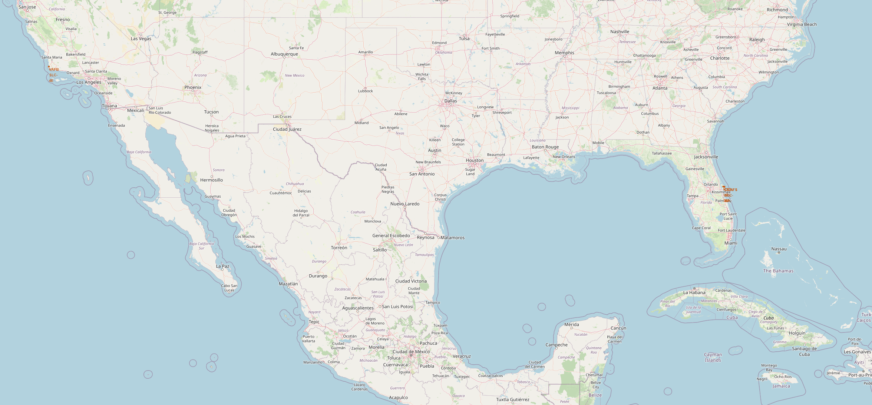
Launch Site locations
The launch sites are located close to the coast in general. In case of a launch mishap or explosion, debris falls away from the launch pad. An ocean provides a vast, mostly unpopulated area for debris to fall into, minimizing the risk of damage or casualties on land.

Slide 36
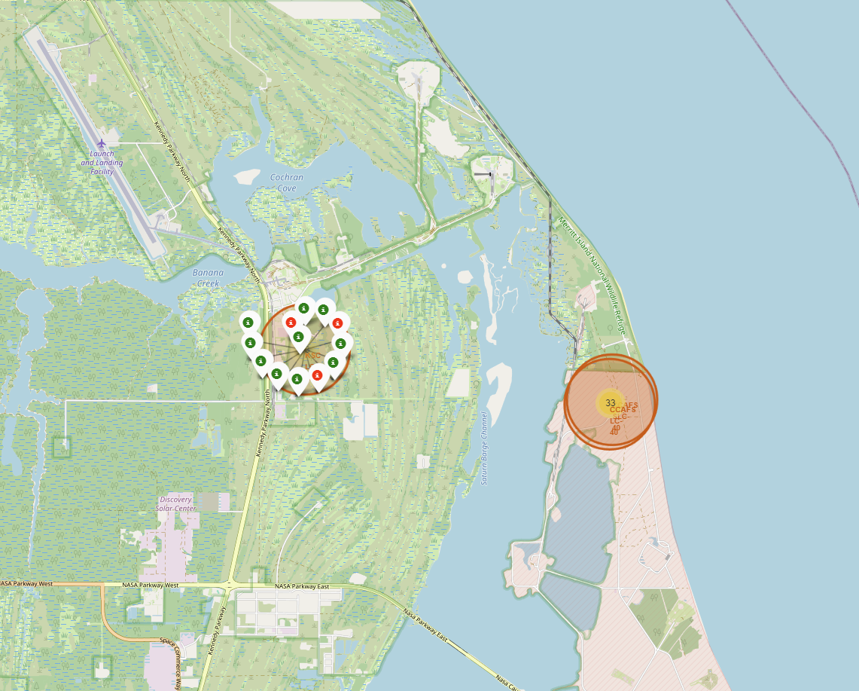
Success Rate shown on map
Replace <Folium map screenshot 2> title with an appropriate title
Explore the folium map and make a proper screenshot to show the color-labeled launch outcomes on the map
Explain the important elements and findings on the screenshot

Slide 37
<Folium Map Screenshot 3>
Replace <Folium map screenshot 3> title with an appropriate title
Explore the generated folium map and show the screenshot of a selected launch site to its proximities such as railway, highway, coastline, with distance calculated and displayed
Explain the important elements and findings on the screenshot

Slide 38

Section 4

Slide 39
<Dashboard Screenshot 1>
Replace <Dashboard screenshot 1> title with an appropriate title
Show the screenshot of launch success count for all sites, in a piechart
Explain the important elements and findings on the screenshot

Slide 40
<Dashboard Screenshot 2>
Replace <Dashboard screenshot 2> title with an appropriate title
Show the screenshot of the piechart for the launch site with highest launch success ratio
Explain the important elements and findings on the screenshot

Slide 41
<Dashboard Screenshot 3>
Replace <Dashboard screenshot 3> title with an appropriate title
Show screenshots of Payload vs. Launch Outcome scatter plot for all sites, with different payload selected in the range slider
Explain the important elements and findings on the screenshot, such as which payload range or booster version have the largest success rate, etc.

Slide 42

Section 5

Slide 43
Classification Accuracy
Visualize the built model accuracy for all built classification models, in a bar chart
Find which model has the highest classification accuracy

Slide 44
Confusion Matrix
Show the confusion matrix of the best performing model with an explanation

Slide 45
Conclusions
Point 1
Point 2
Point 3
Point 4
…

Slide 46
Appendix
Include any relevant assets like Python code snippets, SQL queries, charts, Notebook outputs, or data sets that you may have created during this project

Slide 47


